Slide 1
Business Data Management Capstone Project: An analysis of Sales, Gross Profit and Inventory data of a Private Jute Manufacturing Company
Indian Institute of Technology, Madras
21f1003331@student.onlinedegree.iitm.ac.in
Kisalay Ghosh

Slide 2
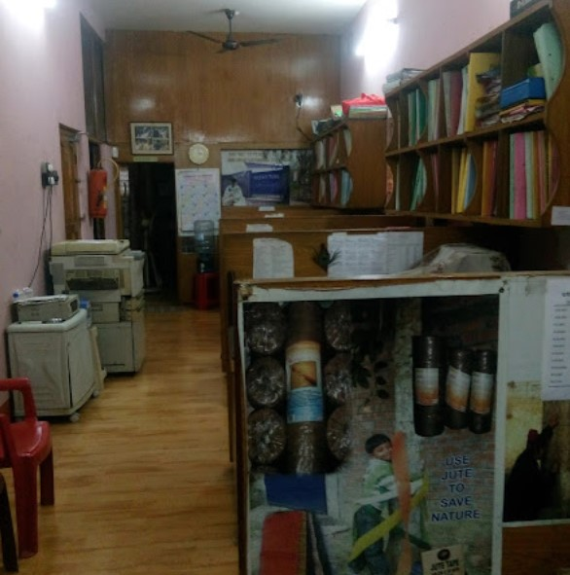
Over View:
Company Name: Basu Jutex Private Limited
Location: Rahara, Khardaha, Kolkata, West Bengal-700118.
Proximity: 10 Km Away from my house.
Type of Buisness: Jute products manufacturer and exporter.
The analysis was done on monthly sales and production data and monthly stock data for the period from July 2021 to December 2021.
Objective is to analyze the overall sales, production, inventory and gross margin.

Slide 3
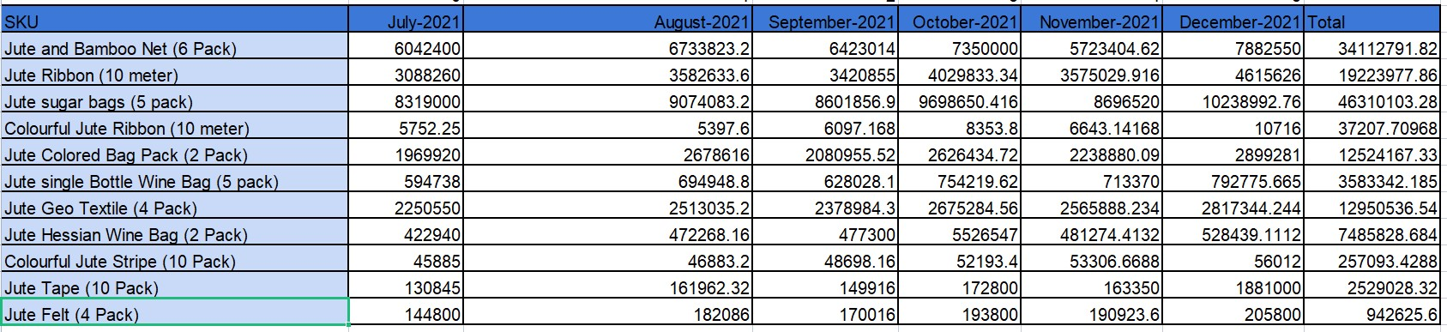
Monthly Revenue Detail
●Even though Jute sugar bags (5 pack) and Jute and Bamboo Net (6 Pack) are the highest earning SKUs, their gross profit is the negative across July 2021 - December 2021. This is because these are common products, and are sold in huge quantities for about average prices. Usually their produced quantities are more than their quantities sold.
●About 3 SKUs are key, contributing 70% of the total sales.
●The Gross margin of the Company is maximum for Jute Hessian Wine Bag (2 Pack) even though it's one of the lowest selling products in the company. This is because Jute Hessian Wine Bag (2 Pack) is a specialized product which is sold to only a selected number of customers in very limited quantities for a very high price. It accounts for almost 75% of the company's profit.

Slide 4
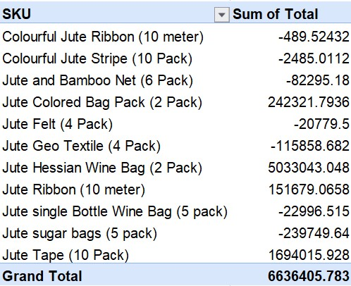
Gross Profit Analysis
● Across all SKUs, Colourful Jute Ribbon (10 meter) is the least profitable product as neither does it give enough revenue, nor does it give enough gross profit.

Slide 5
Recommendations
•Since the company currently has a global presence,and almost has a monopoly in India, the company can control the Jute market with new specialized products and can alter its prices freely without the fear of any serious competition.
•Given the demand for Jute fiber in recent years because of adaptation of biodegradable products competing with cotton fibers, the Company can expand into newer regions without incurring a substantial production cost.
•Since the prices of common products ( Jute and Bamboo Net (6 Pack)& Jute sugar bags (5 pack) ) are at par with its competitors, it has some room for increasing their unit prices so that they can give a positive gross profit so as to balance the cost of production volume to its sales volume.
•Sales and production of Colourful Jute Ribbon (10 meter) should be minimized to a particular requirement so as to minimize the company’s losses.
•Sales of Jute Hessian Wine Bag (2 Pack) can be increased by a limited amount given that it the the most profitable product of the company but not so much as to lose its specialized status in the market. Unit price for Jute Hessian Wine Bag (2 Pack) can also be increased by a certain amount so as to maximize profits but not so much as to drive customers to direct competitors.

